Slide 1


Machine Learning Hands-on
Shin-Han Shiu
Michigan State University
Notes:
Image credit:
https://www.pinterest.com/pin/292945150756287202/
https://www.pinterest.com/pin/549509592004746347/

Slide 2

Logistics
Resource for today’s workshop:
Instruction
The pre-workshop Jupyter notebook
The workshop Jupyter notebook and dataset
This PowerPoint
Avallabile from: https://github.com/ShiuLab/ML_workshop
Code of conduct - behaviors that will not be tolerated:
Any form of discrimination, e.g., based on gender, race, sexual orientation, age, or others.
Any form of harassment, e.g., sexual, verbal, bullying or others
Offensive language or behavior
Deliberate intimidation, sustained disruption.
All those online will be in one group.
Ask directly or use the chat function to raise questions

Slide 3
Goals of this workshop
At the end of this, you should be able to:
Define ML and basic ML terminology
Follow the example in this workshop to solve your own problems
Describe how a model can be evaluated with a performance measure
Explain to others what the major limitations of ML are

Slide 4
Workshop schedule
Components | Duration | Details
Introduction | 5 min | What is machine learning (ML) and why?
Part A review | 10 min | ML workflow revisited
Step 1 | 5 min | Define ML problem
Step 2 | 10 min | Conduct exploratory data analysis
Step 3/4 | 15 min | Split training/testing data and engineer features
Step 5 | 15 min | Select model
Step 6 | 15 min | Repeat 2~5 to get the optimal model
Step 7 | 15 min | Evaluate model
Step 8 | 15 min | Interpret model
Wrap-up | 10 min | What you have done today

Slide 5



Intro: why is ML & why
Knowledge
Consider how we learn
A task, goal, question, or problem
Yes!
Input: Experiences to learn from
Output:
A model making predictions
Answers
Good
enough?
No!

Slide 6

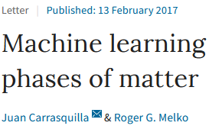
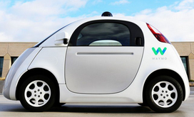
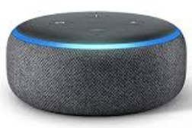
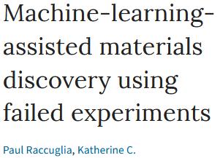
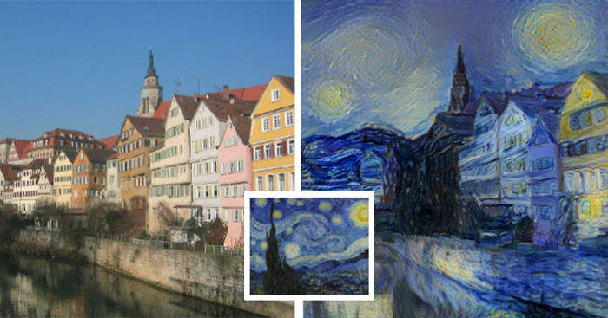
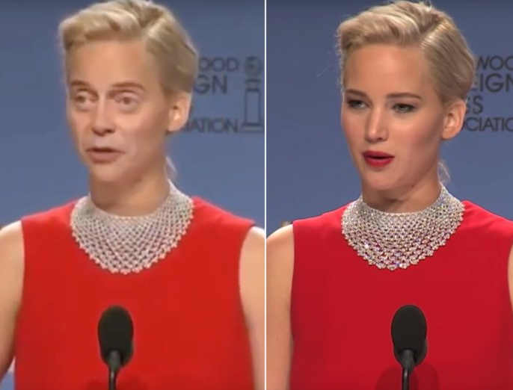
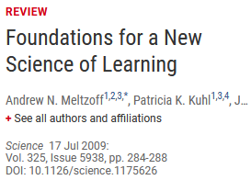

Intro: why is ML & why
ML publications in PubMed as of 3/9/22
As a person
As a scientist
As a biologist
As a plant biologist
Machine learning
Others
(27,249)
Human
(38,487)
Plant (1,848)
Image credits: in notes
Notes:
Image credits:
https://cdn.technologyreview.com/i/images/waymovehicle1.jpg?sw=959&cx=0&cy=466&cw=3000&ch=1687
https://compostables.org/wp-content/uploads/2018/09/All-new-Echo-Dot-3rd-Gen-Smart-speaker-with-Alexa-Sandstone-0.jpg
https://amp.businessinsider.com/images/5c6d85ca2628986f7f3a5d02-750-563.jpg
https://static.boredpanda.com/blog/wp-content/uploads/2015/08/computer-deep-learning-algorithm-painting-masters-fb__700.jpg
https://media.salon.com/2019/01/facial-recognition2.jpg
https://www.greenmangaming.com/newsroom/wp-content/uploads/2019/07/GooglrDeepMind.jpg

Slide 7
Intro: why is ML & why
Address questions
previously not
answerable or
conceived
Growing data: What can we learn and how?
Molecular data
Evolutionary/
ecological data
Assess quantitatively
how much we know
Genomes
Metabolomes
Physiological
measurements
Models
integrating
heterogeneous
info
Provide testable
hypothesis
Transcriptomes
Morphological
measurements
Proteomes
Methylome
Identify potential
issues in the data
Environmental
Microbiomes
ML
algorithms
Interactomes
And more…
Transfer models
to data-poor
areas/species
And more…

Slide 8
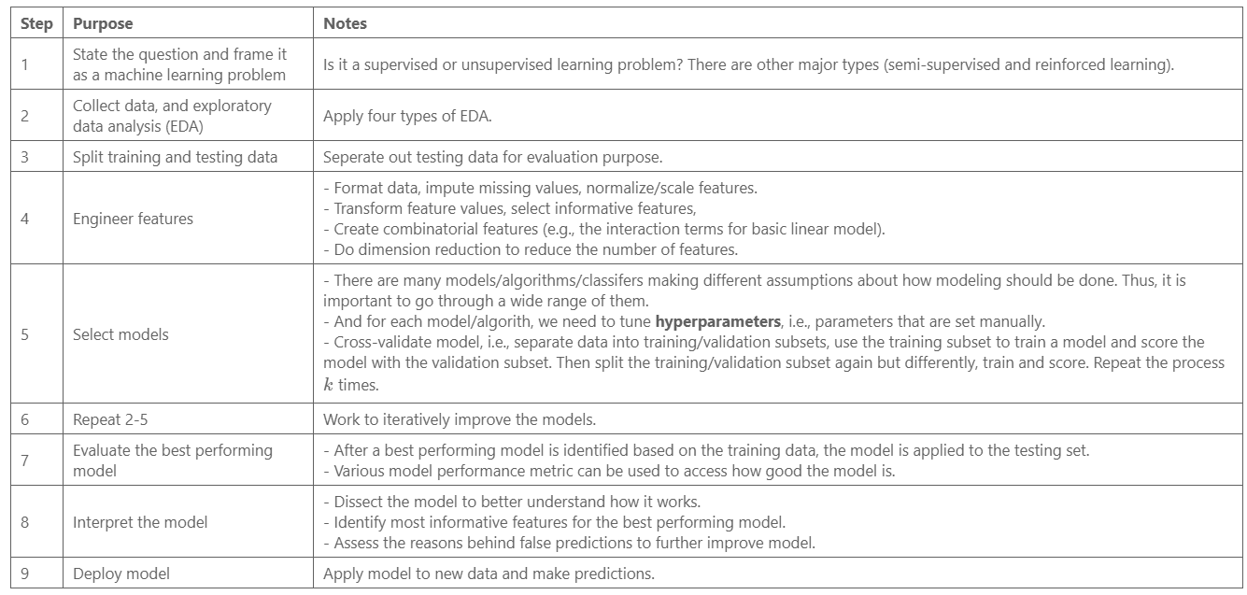
Part A review
Share your understanding of each step with your neighbors and discuss if any step, terminology, or question that you have. in 5~7 minutes, we will bring the group back for a discussion.

Slide 9
Step 1: Define ML problem
Given:
Known genes in general metabolism (GM) or specialized metabolism (SM)
Various features of genes
E.g., expression levels, functional category they belong to
How can we use them to:
Distinguish genes involved in GM from those involved in SM?
QUESTION:
Discuss with your neighbors, what gene features should we use to best distinguish GM and SM genes?

Slide 10
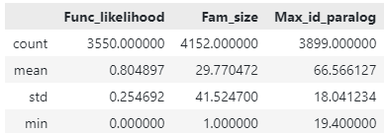
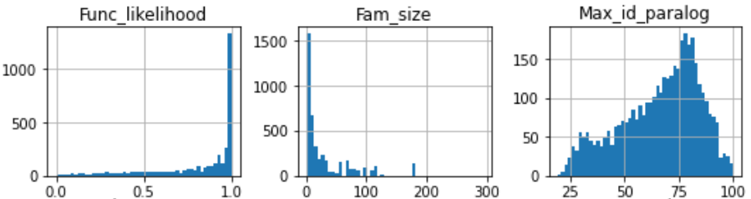
Step 2: Exploratory data analysis (EDA)
Univariate
Non-graphical
Graphical: e.g., histogram
QUESTION:
What problems did you see?
3. Distributions
not normal
1. Unwanted
instances
4. Missing values
2. Varied data
ranges
5. Imbalanced
numbers of labels
Notes:
Unwanted labels
Data range
Non-normal distributions
Different types of data

Slide 11
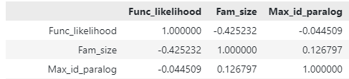
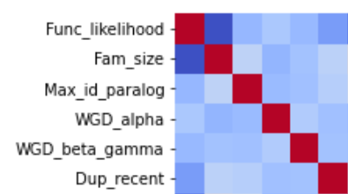
Step 2: Exploratory data analysis (EDA)
Multivariate
Non-graphical: e.g., correlations
Graphical: e.g., heatmap
QUESTION:
What problems did you see?
6. Colinear
variables

Slide 12
Step 3: Split training and testing data
Split data into training and testing sets
Training
1. Unwanted
instances
Training
data
Output:
ML
model
80%
Input:
all instances
all features
Testing
data
Application
Model
Perform-
ance
20%

Slide 13
Step 4: Feature engineering
Process features and identify features relevant to the underlying tasks
Feature
engineering
Training
data
Output:
ML
model
80%
Input:
all instances
all features
Training
Testing
data
Application
Model
Perform-
ance
20%

Slide 14
Step 4: Feature engineering
4.1 Deal with missing data
Drop ALL rows and/or columns
with any missing data
Assume missing values are likely to be close to e.g., the mean value
Assume the missing value of an instance is similar to its neighbors’ value
In our example,
this will throw out ~40% of the data. Not good.
This can be done with SimpleImputer
This can be done with KNNImputer
K-Nearest Neighbor
Notes:
How many problem(s) can you find in this dataset??
1, 3, 5, 7, 9
More information:
https://elitedatascience.com/data-cleaning
https://towardsdatascience.com/the-art-of-cleaning-your-data-b713dbd49726

Slide 15
Step 4: Feature engineering
4.2 Data imbalance
In train_keep_imp
Class 0: 1529 (85%)
Class 1: 272 (15%)
Strategy 1:
Down-sample
Class 0: 272 (50%)
Class 1: 272 (50%)
Strategy 2:
Up-sample
Class 0: 1529 (50%)
Class 1: 1529 (50%)
Strategy 3:
Mixed
Class 0: 611 (50%)
Class 1: 611 (50%)
Model will be biased toward one class.
Many valuable instances are thrown out, lead to underfitting.
Existing data is reused, lead to overfitting.
Tried to mitigate both issues with the middle ground. Not guaranteed to work.
Notes:
How many problem(s) can you find in this dataset??
1, 3, 5, 7, 9
More information:
https://elitedatascience.com/data-cleaning
https://towardsdatascience.com/the-art-of-cleaning-your-data-b713dbd49726

Slide 16
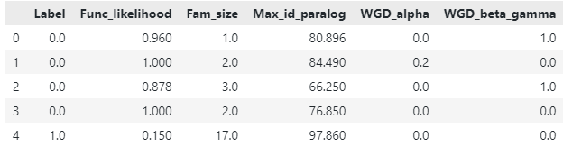
Step 4: Feature engineering
4.2 Data imbalance
Separating labels and features
Labels (y)
Features (X)

Slide 17
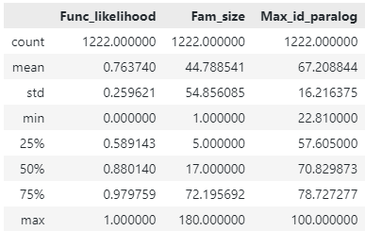
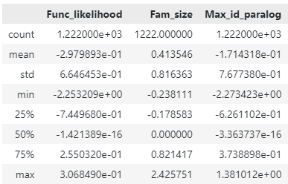
Step 4: Feature engineering
4.3 Data scaling
Notes:
How many problem(s) can you find in this dataset??
1, 3, 5, 7, 9
More information:
https://elitedatascience.com/data-cleaning
https://towardsdatascience.com/the-art-of-cleaning-your-data-b713dbd49726

Slide 18
Step 5: Model/algorithm selection
Choosing among candidate models
Model
selection
Training
data
Output:
ML
model
80%
Input:
all instances
all features
Training
Testing
data
Application
Model
Perform-
ance
20%

Slide 19

Why would there be many models?
Reason 1: There are a lot of algorithms.

Slide 20
Step 5: Model/algorithm selection
Each algorithm has its own hyperparameters
You need to find out which parameters are the best…
RandomForestRegressor
n_estimators, default=100
max_depth, default=None
min_samples_split, default=2
min_samples_leaf, default=1
max_features, default=”auto”
…
(many more)
Say we try:
n_estimator = [10, 50, 100, 200, 500]
max_depth = [2, 4, 5]
min_samples_split = [2, 4, 8]
min_samples_leaf = [1, 2, 3]
max_features = [‘auto’, ‘sqrt’, ‘log2’]
Then we would run the regressor:
5 x 3 x 3 x 3 x 3 = 405 times

Slide 21

Step 5: Model/algorithm selection
And, for each hyperparameter combinations, you need to do:
Cross validation
1
2
3
4
5
6
7
8
9
10
Cross-validation folds
Split
training
data
Model
Input:
training
instances
Training
Set
(90%)
Validation
Set
(10%)
Average model performance
Performance

Slide 22
Step 5: Model/algorithm selection
Finally, you need to decide which hyperparameter combinations give you the best model, e.g.:
Receiver-Operating Characteristic-Area Under Curve (ROC-AUC)
1
There are many other possible choices:
https://scikit-learn.org/stable/modules/model_evaluation.html
0.97
 |  | Truth
 |  | 1 | 0
Prediction | 1 | TP | FP
 | 0 | FN | TN
0.8
True positive (TP) rate
0.9
0.5 (random guess)
0
0
1
False positive (FP) rate

Slide 23
Step 6: Repeat step 2~5
Try different…
data balancing methods
New features
Combina-tions of features
Cross-validation schemes
An “optimal” model
based on
training data
Imputation techniques
Feature transfor-mation
Numbers of features
Models/
algorithms
Numbers of features
Data scalers
Feature dimension reduction
Parameter search methods
Hyper-parameters

Slide 24
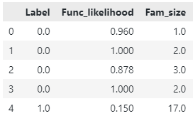
Step 6: Repeat step 2~5
Feature selection
Determining how important a feature is through permutation
Importance
proportional to
reduction in
model performance
Original model
“Permuted” model

Slide 25
Step 7: Evaluate model
 |  | Truth
 |  | 1 | 0
Prediction | 1 | 100 | 0
 | 0 | 0 | 100
Apply model to the test set
By creating a confusion matrix
Then calculate evaluation metrics (e.g., ROC=AUC
Training
data
Output:
ML
model
80%
Input:
all instances
all features
Training
Testing
data
Application
Model
Perform-
ance
20%

Slide 26
Step 8: Interpret model
Apply model to the test set
By creating a confusion matrix
Then calculate evaluation metrics (e.g., ROC=AUC

Slide 27

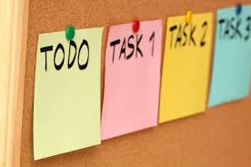
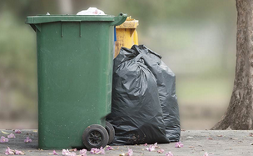

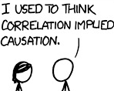
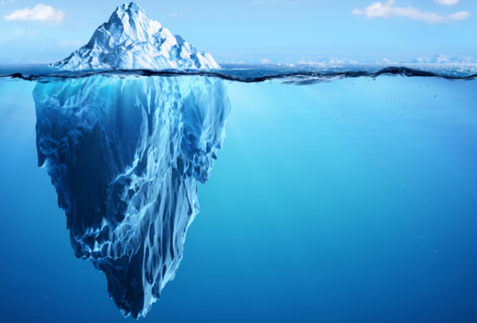
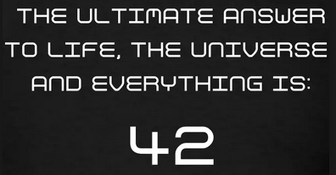
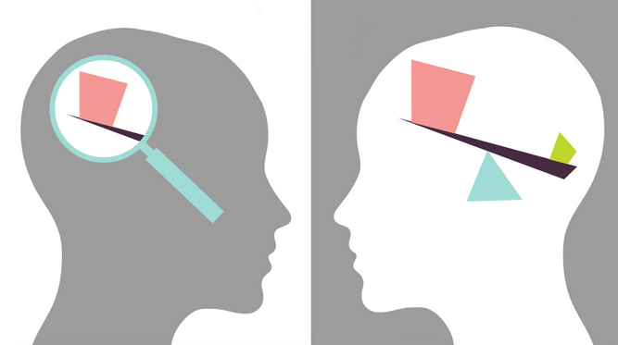
Limitations of ML
Specific model need for each task
High quality & quantity of data
“Here we see that models, despite their reputation for impartiality, reflect goals and ideology. When I removed the possibility of eating Pop-Tarts at every meal, I was imposing my ideology on the meals model. It’s something we do without a second thought. Our own values and desires influence our choices, from the data we choose to collect to the questions we ask. Models are opinions embedded in mathematics.”
Model reusability low
Supervised learning need labels
Pair | Fitness
G1-G2 | 0.9
G1-G3 | 0.1
…
Correlation NOT causation
Hidden variables
Model can be hard to
understand
Unknown bias in the data
Notes:
Image credit:
https://live.staticflickr.com/2615/4026814703_1e41b03876.jpg
https://upload.wikimedia.org/wikipedia/commons/a/af/Reduce_Reuse_Recycle.jpg
https://discover.rbcroyalbank.com/wp-content/uploads/banner-small-garbage-day_402x-1.jpg
http://intranetfactory.com/content2/image.axd?picture=2010%2F11%2Fistock_000011760242xsmall.jpg
https://image.spreadshirtmedia.com/image-server/v1/compositions/15153709/views/1,width=650,height=650,appearanceId=2,version=1547213188/hitchhikers-guide-42-t-shirt-all-our-hitchhikers-guide-products-are-unique-works-of-art-not-available-commercially-international-shipping-availabl.jpg
https://cdn.iconscout.com/icon/free/png-256/discount-ribbon-tag-label-sale-shop-shopping-1-24561.png
https://cdn.searchenginejournal.com/wp-content/uploads/2017/09/Untitled-design-10-760x400.png
https://www.vision.org/sites/default/files/img/2015fall_checking-the-bias_1920x1080.jpg

Slide 28

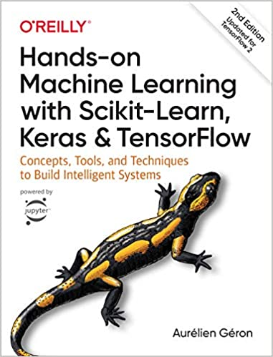
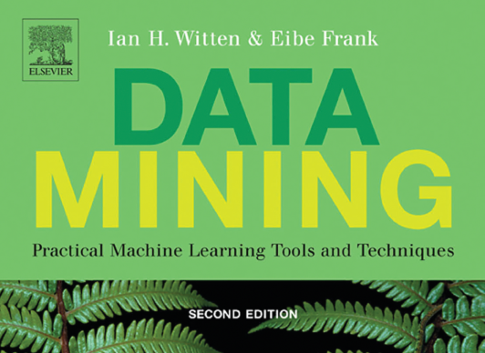

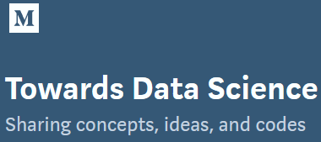
Resources
This workshop
https://github.com/ShiuLab/ML_workshop
Online course
Blog

Slide 29
Thanks for coming…
Before we break, any question?

Slide 30
Step 2: Data collection /processing
Value scaling (continuous) and encoding (discrete)
Instances
Labels
Features
Instances
Labels
Features
Gene pairs | Fitness | Expr cor. | Physical Interact | Double mutant pheno.
G1-G2 | 0.002 | 10 | NO | Severe
G1-G3 | 0.1 | 20 | NO | Mild
G1-G4 | 0.05 | 18 | YES | NO
G1-G5 | 0.8 | 2945 | YES | NO
G2-G3 | 1.2 | 189 | YES | Severe
G1-G2 | 0.3 | 10 | NO | Mild
.. | .. | .. | .. | ..
Gene pairs | Fitness | Expr cor. | Physical Interact | Double severe | Double mild
G1-G2 | 0.002 | -0.44 | 0 | 1 | 0
G1-G3 | 0.1 | -0.43 | 0 | 0 | 1
G1-G4 | 0.05 | -0.43 | 1 | 0 | 0
G1-G5 | 0.8 | 2.04 | 1 | 0 | 0
G2-G3 | 1.2 | -0.29 | 1 | 1 | 0
G1-G2 | 0.3 | -0.44 | 0 | 0 | 1
.. | .. | .. | .. | .. | …
Standard scaling
Binari-zation
One-hot
encoding
Notes:
How many problem(s) can you find in this dataset??
1, 3, 5, 7, 9
More information:
https://elitedatascience.com/data-cleaning
https://towardsdatascience.com/the-art-of-cleaning-your-data-b713dbd49726

Slide 31
Step 3:
WHICH
FEATURES
YOU SHOULD USE AND IN WHAT
FORM
?

Slide 32
Step 3: Feature engineering
Recall…
What features should be included?
Instances
Labels
Features
E.g. transcriptome
Expert knowledge/
literature
Exp1
Gene Pair | Fitness | Feat 1 | Feat 2 | Feat 3
Exp1
Exp1
Exp1
Exp1
Trans-
formation
Exp1
Exp X
“Raw”
features
“Derived”
features
 | Expression levels
Gene | Exp A | Exp B | Exp C | ..
1
2
3
4
..
 | Log10(expr level)
Gene | Exp A | Exp B | Exp C | ..
1
2
3
4
..
 | Expr correlation
Gene | 1 | 2 | 3 | ..
1
2
3
4
..
Task: Learn a model using features to predict double
mutant fitness

Slide 33
Step 3: Feature engineering
Ok, we have tones of features, should we just use all of them?
Why?
How to select features?
Those with strongest relationships with the labels
 | With domain 1 | Without domain 1
In PWY A | 100 | 0
Not in PWY A | 0 | 30,000
NO!
Most features are not relevant
Some features are redundant
Making prediction with noise
Those with “high importance” in the model
Generated by most ML algorithms
More features
More compli-cated models
Harder to figure out how it works
https://machinelearningmastery.com/an-introduction-to-feature-selection/

Slide 34
Step 5: Model/algorithm selection
How the algorithm work
Decision tree
A genes:5
Non-A genes: 5
Gene | Label | Control shoot transcript level | Herbivory root transcript level
1 | 0 | 0 | 391
2 | 0 | 24 | 111
3 | 0 | 40 | 163
4 | 0 | 100 | 350
5 | 0 | 45 | 23
6 | 1 | 290 | 200
7 | 1 | 124 | 220
8 | 1 | 235 | 120
9 | 1 | 7 | 250
10 | 1 | 352 | 261
Control shoot
transcript Level
≥102
<102
A genes:0
Non-A genes: 4
A genes:5
Non-A genes: 1
Herbivory root
transcript Level
≥300
<300
Linear
decision boundary
Support vector machine
Non-linear decision boundary
A genes:1
Non-A genes: 0
A genes:3
Non-A genes: 1

Slide 35
Step 3: Feature engineering
Process of feature engineering
Training
data
Fit
Inter-
mediate
model
Measures of
feature
importance
Output:
FINAL
model
Transform
Modified
Training
data

Slide 36


Step 4 Model/algorithm selection
Step 1:
Identifying problems
Step 2:
Data collection/
cleaning
Step 3:
Feature engineering
Step 4: Model/algorithm selection
Step 5:
Model application/
interpretation
New data
X | ? | …
Y | ? | …
Instances
Label
Features
Gene | Up-reg | Seq1 | Seq2 | …
A | 1 | 1 | 1 | …
B | 1 | 1 | 1 | …
C | 0 | 0 | 0 | …
D | 0 | 0 | 1 | …
… | … | … | … | …
New data
X | 1 | …
Y | 0 | …
Datasets
What questions would you like to ask?
What data should you use?
What features should be used?
Which algorithms and parameters to use?
How should we interpret the results?

Slide 37
Step 4:
WHICH
ALGORITHMs/
PARAMETERS
TO USE
?

Slide 38
Step 4b: Model evaluation
Pathway A |  | Truth
 |  | Is | Is not
Prediction | Is | 5 | 1 | 83%
 | Is not | 0 | 4 | 100%
 |  | 100% | 80%
Real
data
Random
data
Perfect
data
Model eval
Gene | PWY A | Control shoot transcript level
1 | YES | 0
2 | YES | 24
3 | YES | 40
4 | YES | 100
5 | YES | 45
6 | NO | 290
7 | NO | 124
8 | NO | 235
9 | NO | 7
10 | NO | 400
400
10
10
10
True positive rate
True negative rate
6
3
6
8
Not
A
8
8
7
7
7
4
4
9
Is A
5
5
5
True positive rate
3
6
3
2
2
2
Model: Control shoot transcript level is predictive of PWY A membership
9
9
4
0
1
1
1
False negative rate (1 - True negative rate)

Slide 39
Step 5 Model application/interpretation
Step 1:
Identifying problems
Step 2:
Data collection/
cleaning
Step 3:
Feature engineering
Step 4: Model/algorithm selection
Step 5:
Model application/
interpretation
New data
X | ? | …
Y | ? | …
Instances
Label
Features
Gene | Up-reg | Seq1 | Seq2 | …
A | 1 | 1 | 1 | …
B | 1 | 1 | 1 | …
C | 0 | 0 | 0 | …
D | 0 | 0 | 1 | …
… | … | … | … | …
New data
X | 1 | …
Y | 0 | …
Datasets
What questions would you like to ask?
What data should you use?
What features should be used?
Which algorithms and parameters to use?
How should we interpret the results?

Slide 40
Step 5:
HOW TO APPLY MODELS TO
NEW CASES AND
MAKE SENSE OF THE PREDICTIONS
?

Slide 41
Step 5: Model application/interpretation
Evaluate how well the model work with the independent, testing data
Training
Output:
ML
model
Training
data
80%
Input:
all instances
all features
Application
Testing
data
Model
Perform-
ance
20%
Application
New
data
Predictions

Slide 42
Discussion 2
Reflection
(2 min)
Think about how you may answer this:
What do you perceive as the challenges for you to adopt ML?
Groups of 3-5
(8 min)
Share within your group
The challenges you face.
What resources will be useful for you to meet the challenges?
Whole workshop
(10 min)
Report back!

Slide 43
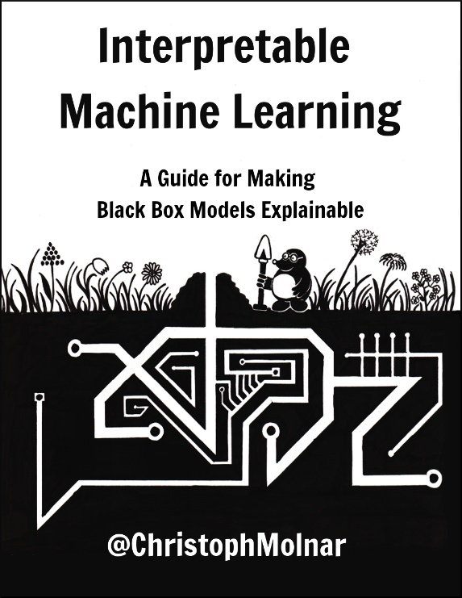
Step 5: model application/interpretation
Interpretation
Decision tree
A genes:5
Non-A genes: 5
If control shoot ≥102:
then not A
else:
if herbivory root ≥300:
then A
else:
75% chance A
Umm…. What??
Control shoot
transcript Level
≥102
<102
A genes:0
Non-A genes: 4
A genes:5
Non-A genes: 1
Herbivory root
transcript Level
≥300
<300
Decision boundary
Support vector machine
Non-linear decision boundary
A genes:1
Non-A genes: 0
A genes:3
Non-A genes: 1

Slide 44
Spare

Slide 45
Step 1: Define ML problem
Given data
Machine learning problem
Different properties (features) of genes
(1)
Unsupervised learning problem?
How well do clusters correspond to GM and SM genes?
(2)
Classification problem?
How can we classify genes into GM and SM classes?
Gene | SM or GM | Has function A | Expr level
1 | SM | YES | 10
2 | GM | NO | 108
3 | GM | YES | 1
4 | GM | NO | 12
5 | SM | NO | 21
6 | GM | YES | 33
.. | .. | .. | ..
(3)
Regression
problem?
How can we predict expression levels of genes?
Notes:
This kind of biological question can be rephrased in which of the following machine learning problem statement(s)?

Slide 46

Step 4: Feature engineering
Poll
How many problems can you find in the dataset?
Format
Instances
Labels
Features
Data quality
Gene pairs | Fitness | Expr cor. 1 | Expr cor. 2 | Physical Interact | Double mutant pheno.
G1-G2 | 0.002 | 90 | 10 | NO | Severe
G1-G3 | 1.1 | ? | ? | NO | ?
G1-G4 | - | 20 | 18 | ? | NO
G1-G5 | 0.2 | 1234201 | 2945 | YES | NO
G2-G3 | 0.9 | 15 | 189 | Y | Sevvere
G1-G2 | 0.03 | 90 | 10 | NO | Mild
G2-G5 | Unsure | 240 | 30 | NO | Mild
.. | .. | .. | .. | .. | ..
Missing data
Missing data
Typo
Duplicate
Irrelevant to the task
Inconsistent value format
Outlier
Notes:
How many problem(s) can you find in this dataset??
1, 3, 5, 7, 9
More information:
https://elitedatascience.com/data-cleaning
https://towardsdatascience.com/the-art-of-cleaning-your-data-b713dbd49726

Slide 47
Step 3.5: Splitting data into training and testing
Pathway A |  | Truth
 |  | Is | Is not
Prediction | Is | 45 | 10 | 82%
 | Is not | 5 | 40 | 89%
 |  | 90% | 80%
Start over…
Feature
selection
algorithms
ML
algorithms
Input:
training
instances
Selected
features
Output:
ML
model
Model
Performance
Based on
training
instances
Answers
Good
enough?
Input:
training
instances
all features
90%
Input:
all instances
all features
No!
Yes!
Input:
testing
instances
all features
Input:
training
instances
Selected
features
10%
Input:
New instances
Predictions
New
instances
Pathway A |  | Truth
 |  | Is | Is not
Prediction | Is | 35 | 17 | 67%
 | Is not | 15 | 33 | 69%
 |  | 70% | 66%
Model
Performance
Based on
testing
instances

Slide 48
Step 3.5: Splitting data into training and testing
Is the
model
really
that good?
Why…
Task:
Predict genes in pathway A
Pathway A |  | Truth
 |  | Is | Is not
Prediction | Is | 25 | 25 | 50%
 | Is not | 25 | 25 | 50%
 |  | 50% | 50%
Pathway A |  | Truth
 |  | Is | Is not
Prediction | Is | 40 | 20 | 67%
 | Is not | 10 | 30 | 75%
 |  | 80% | 60%
Pathway A |  | Truth
 |  | Is | Is not
Prediction | Is | 45 | 10 | 82%
 | Is not | 5 | 40 | 89%
 |  | 90% | 80%
Knowing (truth):
50 genes in X
50 genes not in X
Feature
selection
algorithms
ML
algorithms
Answers
Good
enough?
Input:
all instances
all features
Input:
all instances
selected
features
Output:
ML
model
Model performance
based on
all instances
Yes!
Input:
New instances
Predictions
New
instances
No!
How do you
know that the
model works?
True positive rate
Positive predictive value
True negative rate
Negative predictive value

Slide 49
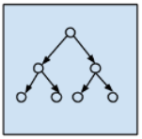
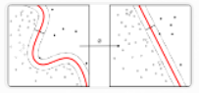
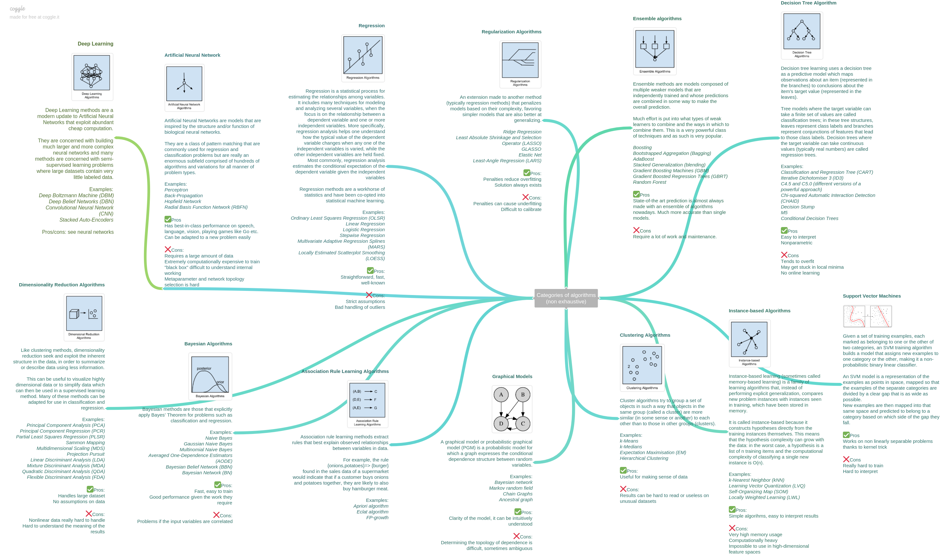
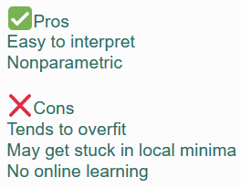
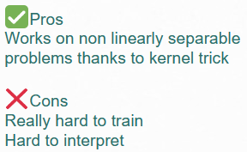
Step 4: Model/algorithm selection
ML
algorithms
Which algorithms should we use?
Input
data
ML
model
https://static.coggle.it/diagram/WHeBqDIrJRk-kDDY/t/categories-of-algorithms-non-exhaustive

Slide 50
What kinds of questions can be addressed
Supervised learning
Unsupervised learning
Instances
Labels
Features
Instances
Features
Gene | PWY A | Expr level | Has domain A | Dev. Defect
1 | YES | 90 | NO | Severe
2 | NO | 85 | NO | Mild
3 | YES | 80 | NO | NO
4 | NO | 70 | YES | NO
5 | NO | 65 | YES | Severe
6 | YES | 60 | NO | Mild
.. | .. | .. | .. | ..
Gene | PWY A | Expr level | Has domain A | Dev. Defect
1 | YES | 90 | NO | Severe
2 | NO | 85 | NO | Mild
3 | YES | 80 | NO | NO
4 | NO | 70 | YES | NO
5 | NO | 65 | YES | Severe
6 | YES | 60 | NO | Mild
.. | .. | .. | .. | ..
Task: Learn which gene may belong to pathway A
Task: Learn some unspecified patterns from the data

Slide 51
How does ML work
Five steps
Step 1:
Identifying problems
Step 2:
Data collection/
cleaning
Step 3:
Feature engineering
Step 4: Model/algorithm selection
Step 5:
Model application/
interpretation
New data
X | ? | …
Y | ? | …
Instances
Label
Features
Gene | Up-reg | Seq1 | Seq2 | …
A | 1 | 1 | 1 | …
B | 1 | 1 | 1 | …
C | 0 | 0 | 0 | …
D | 0 | 0 | 1 | …
… | … | … | … | …
New data
X | 1 | …
Y | 0 | …
Datasets
What questions would you like to ask?
What data should you use?
What features should be used?
Which algorithms and parameters to use?
How should we interpret the results?

Slide 52
What kinds of questions can be addressed
Classification
Regression
Instances
Labels
Instances
Labels
Gene | PWY A | Expr level | Has domain A | Dev. Defect
1 | YES | 90 | NO | Severe
2 | NO | 85 | NO | Mild
3 | YES | 80 | NO | NO
4 | NO | 70 | YES | NO
5 | NO | 65 | YES | Severe
6 | YES | 60 | NO | Mild
.. | .. | .. | .. | ..
Gene | PWY A | Expr level | Has domain A | Dev. Defect
1 | YES | 90 | NO | Severe
2 | NO | 85 | NO | Mild
3 | YES | 80 | NO | NO
4 | NO | 70 | YES | NO
5 | NO | 65 | YES | Severe
6 | YES | 60 | NO | Mild
.. | .. | .. | .. | ..
Task: Learn if a gene belong to PWY A
Task: Learn how to predict expression level

Slide 53
Step 4: Model/algorithm selection
Feature
selection
algorithms
ML
algorithms
Input:
training
instances
all features
Input:
training
instances
Selected
features
Output:
ML
model
Performance
Based on
training
instances
80%
Input:
all instances
all features
Input:
testing
instances
all features
20%
Task:
Predict genes in pathway A
Pathway A |  | Truth
 |  | Is | Is not
Prediction | Is | 25 | 25 | 50%
 | Is not | 25 | 25 | 50%
 |  | 50% | 50%
Pathway A |  | Truth
 |  | Is | Is not
Prediction | Is | 45 | 10 | 82%
 | Is not | 5 | 40 | 89%
 |  | 90% | 80%
Knowing (truth):
50 genes in A
50 genes not in A

Slide 54
Step 4b: Model evaluation
Pathway A |  | Truth
 |  | Is | Is not
Prediction | Is | 45 | 10 | 82%
 | Is not | 5 | 40 | 89%
 |  | 90% | 80%
With the independent testing set
Feature
selection
ML
algorithms
Input:
training
instances
all features
Input:
training
instances
Selected
features
Output:
ML
model
Model
Performance
Based on
training
instances
90%
Input:
all instances
all features
FINAL
MODEL
Input:
testing
instances
all features
Input:
testing
instances
Selected
features
10%
Pathway A |  | Truth
 |  | Is | Is not
Prediction | Is | 35 | 17 | 67%
 | Is not | 15 | 33 | 69%
 |  | 70% | 66%
Model
Performance
Based on
testing
instances

Slide 55
Step 5: Model application/interpretation
Application on new instances
Feature
selection
ML
algorithms
Input:
training
instances
all features
Input:
training
instances
Selected
features
Output:
ML
model
Model
Performance
Based on
training
instances
90%
Input:
all instances
all features
FINAL
MODEL
Input:
testing
instances
all features
Input:
training
instances
Selected
features
10%
Gene | PWY A | Control shoot transcript level | Herbivory root transcript level
W | ? | 30 | 101
X | ? | 65 | 123
Y | ? | 311 | 249
Z | ? | 127 | 250
Model
Performance
Based on
testing
instances
YES
YES
NO
NO
New
data

Slide 56
What kinds of questions can be addressed
Supervised learning
Unsupervised learning
Instances
Labels
Features
Instances
Variables
Gene | PWY A | Expr level | Has domain A | Dev. Defect
1 | YES | 90 | NO | Severe
2 | NO | 85 | NO | Mild
3 | YES | 80 | NO | NO
4 | NO | 70 | YES | NO
5 | NO | 65 | YES | Severe
6 | YES | 60 | NO | Mild
.. | .. | .. | .. | ..
Gene | Expr level | Has domain A | Dev. Defect
1 | 90 | NO | Severe
2 | 85 | NO | Mild
3 | 80 | NO | NO
4 | 70 | YES | NO
5 | 65 | YES | Severe
6 | 60 | NO | Mild
.. | .. | .. | ..
Semi-
supervised
learning
Reinforce-ment learning
Task: Learn which gene may belong to pathway A
Task: Learn some unspecified patterns from the data

Slide 57
Summary
Recall our goals
Define ML and basic ML terminology
Identify what kinds of problems that can be solved with ML
Describe how a model can be evaluated with a performance measure
Explain to others what the major limitations of ML are

